Slide 1
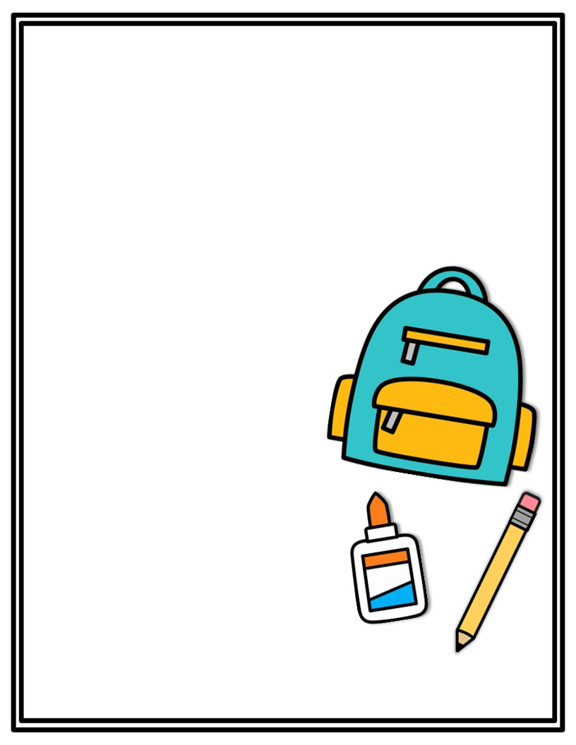
Kindergarten Supply List
2024-2025 School Year
Please only label your headphones, pencil box, lunchbox, water bottle and backpack. ☺
12 or more glue sticks
1 box washable markers
3 Pack Thin Black EXPO Markers
1 Pack Black Chisel EXPO Markers
2 Containers Clorox Wipes
4 Packs of 24 count Crayola Crayons
2 Plastic Pencil Boxes
2 pack #2 Ticonderoga Pencils
1 pair of Wired Headphones (no earbuds please)
1 pair of Scissors
2 Hand Sanitizer Bottles
2 Copy Paper Reams
1 Pack of Classic 15oz Play-Doh
1 Primary Journal with drawing space
2 Boxes of Tissues
2 Blue Plastic Folders with Prongs
Wish List Items:
Sheet Protectors
Sidewalk Chalk
Colored paper
Post it Notes
Clear Packing Tape
Sharpies
Gallon Ziplock Bags
Elmers Liquid Glue
1 Roll of Paper Towels
1 Box of Colored Pencils
Thank you for all the support!
- The Kindergarten Team ☺

